Slide 1
Terraform

Slide 2
Topics
IaC
Terraform
Terraform vs ARM Templates
Terraform vs CloudFormation
Terraform Architecture
Workflow
State File
Example: VM Creation in Azure
Variables
Conditioning in Terraform
Iterations in Terraform
Operators In Terraform
Data Source in Terraform
Terraform Functions
Terraform Modules
Terraform Workspace

Slide 3
Infrastructure as a Code
Provisioning infrastructure through software to achieve consistent and predictable environments
Automated deployment
Consistent environments
Repeatable process
Reusable components
Documented architecture

Slide 4
Terraform
A provisioning declarative tool that based on Infrastructure as a Code paradigm
Uses own syntax - HCL (Hashicorp Configuration Language)
Written in Golang.
Helps to evolve you infrastructure, safely and predictably
Applies Graph Theory to IaaC
Terraform is a multipurpose composition tool: ○ Composes multiple tiers (SaaS/PaaS/IaaS) ○ A plugin-based architecture model
Open source. Backed by Hashicorp company and Hashicorp Tao (Guide/Principles/Design)

Slide 5
Other IaC Tools
CloudFormation, Heat, ARM Templates etc.
Ansible, Chef, Puppet, etc.
Boto, fog, apache-libcloud, etc.
Custom tooling and scripting

Slide 6
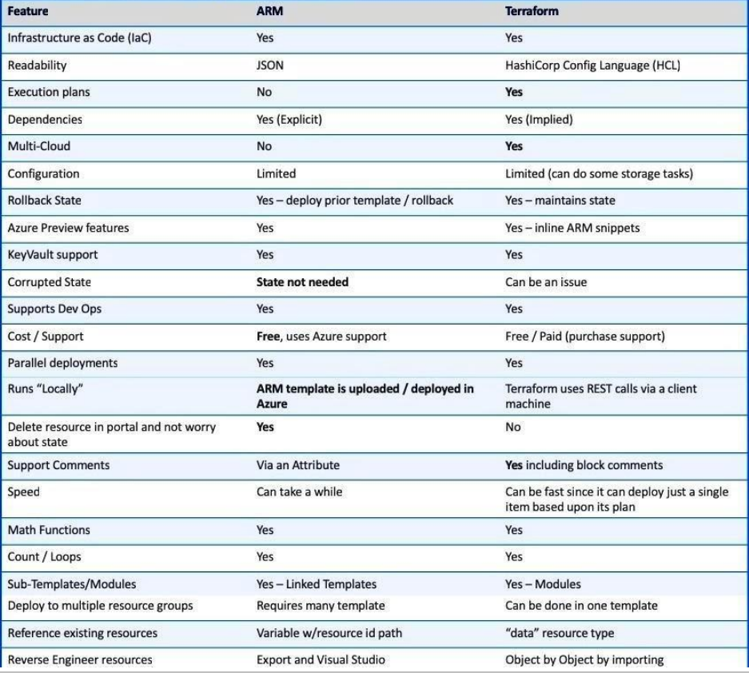
Terraform vs ARM Templates

Slide 7
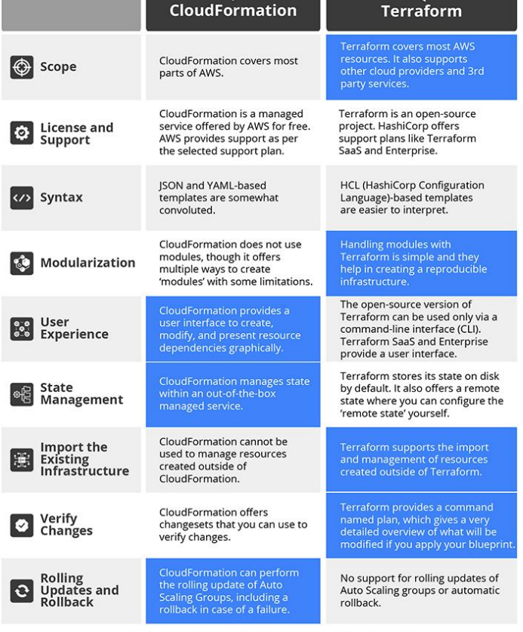
Terraform vs CloudFormation

Slide 8
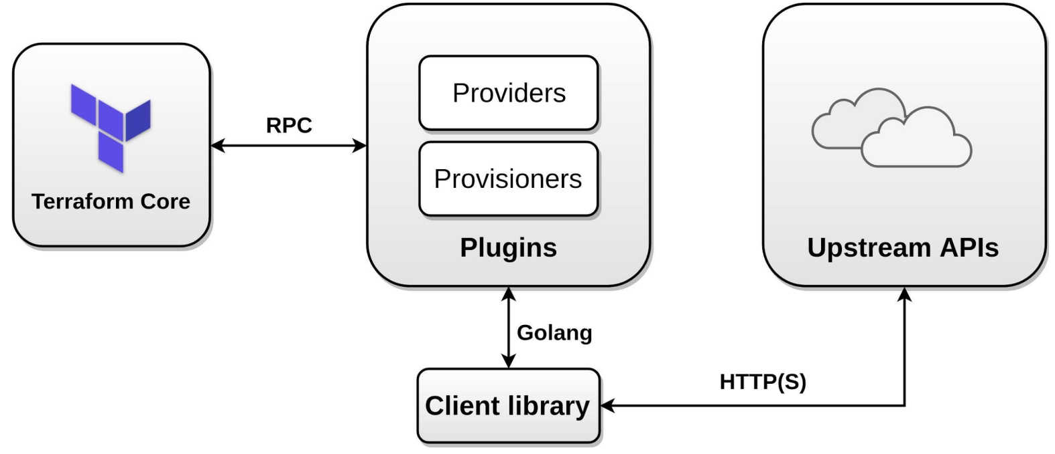
Terraform Architecture

Slide 9
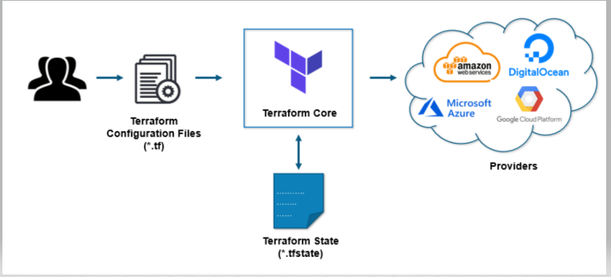
Terraform Architecture

Slide 10
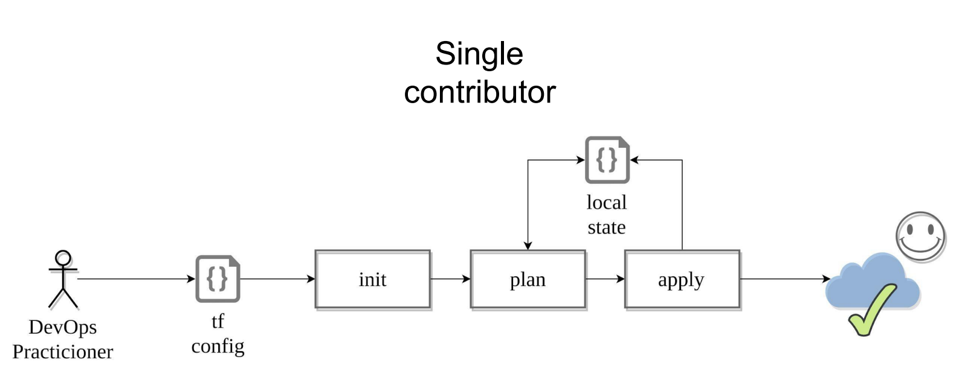
Workflow

Slide 11
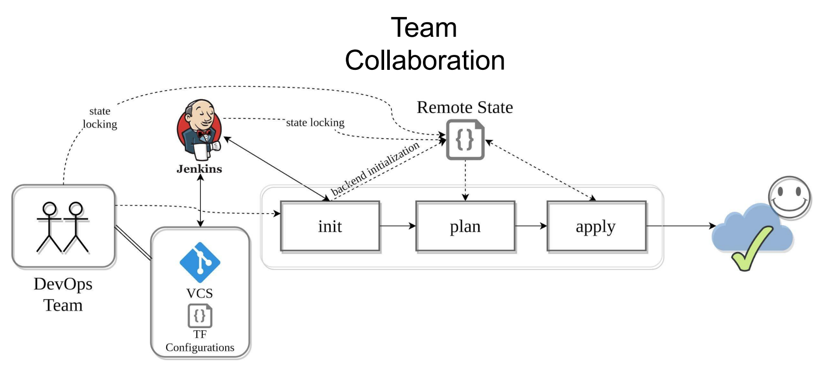
Workflow

Slide 12
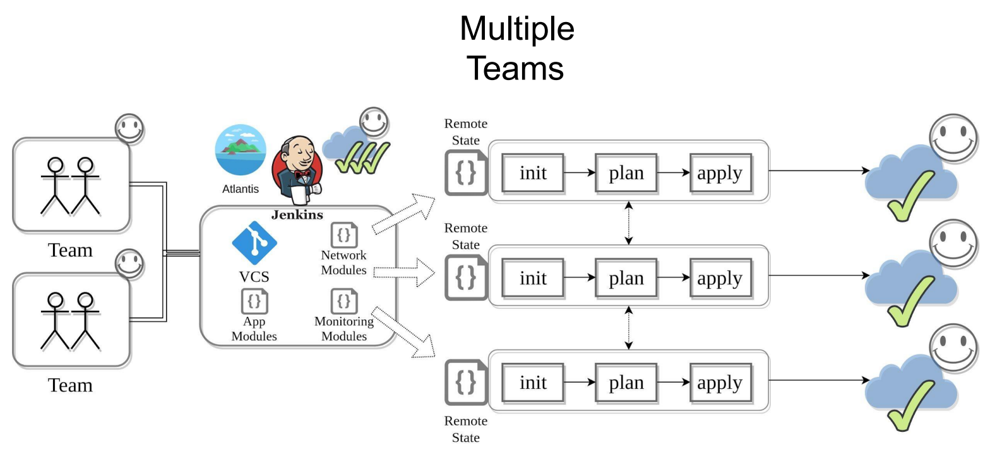
Workflow

Slide 13
State File
Backup your state files + use Versioning and Encryption
Do Not edit manually!
Main Keys: cat terraform.tfstate.backup | jq 'keys' a. "lineage" - Unique ID, persists after initialization b. "modules" - Main section c. "serial" - Increment number d. "terraform_version" - Implicit constraint e. "version" - state format version
Use “terraform state” command a. mv - to move/rename modules b. rm - to safely remove resource from the state. (destroy/retain like) c. pull - to observe current remote state d. list & show - to write/debug modules

Slide 14
State File
Terraform keeps the remote state of the infrastructure
It stores it in a file called terraform.tfstate
There is also a backup of the previous state in terraform.tfstate.backup
When you execute terraform apply, a new terraform.tfstate and backup is written
This is how terraform keeps track of the remote state
If the remote state changes and you hit terraform apply again, terraform will make changes to meet the correct remote state again
e.g. you terminate an instance that is managed by terraform, after terraform apply it will be started again

Slide 15
State File
You can keep the terraform.tfstate in version control
e.g. git
It gives you a history of your terraform.tfstate file (which is just a big JSON file) • It allows you to collaborate with other team members
Unfortunately you can get conflicts when 2 people work at the same time
Local state works well in the beginning, but when you project becomes bigger, you might want to store your state remote

Slide 16
Example: VM Creation in Azure

Slide 17
Variables
Input Variables
Output values
Local Values

Slide 18
Input Variables
Input variables serve as parameters for a Terraform module/Terrform code, allowing aspects of the module/Terrform code to be customized without altering the module's own source code, and allowing modules to be shared between different configurations.
When you declare variables in the root module of your configuration, you can set their values using CLI options and environment variables.
When you declare them in child modules, the calling module should pass values in the module block.

Slide 19
Input Variable Types
String
Number
List
Map
Boolean
Set
Object
Tuple

Slide 20
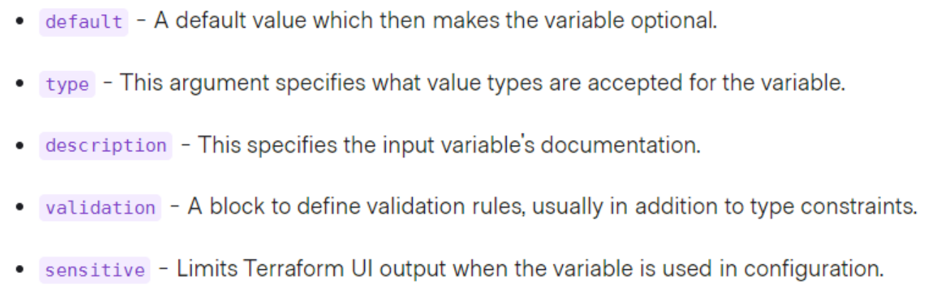
Input Variables
Variable blocks have 5 optional arguments.
We recommend setting a description and type for all variables, and setting a default value when practical.
If you do not set a default value for a variable, you must assign a value before Terraform can apply the configuration. Terraform does not support unassigned variables.

Slide 21
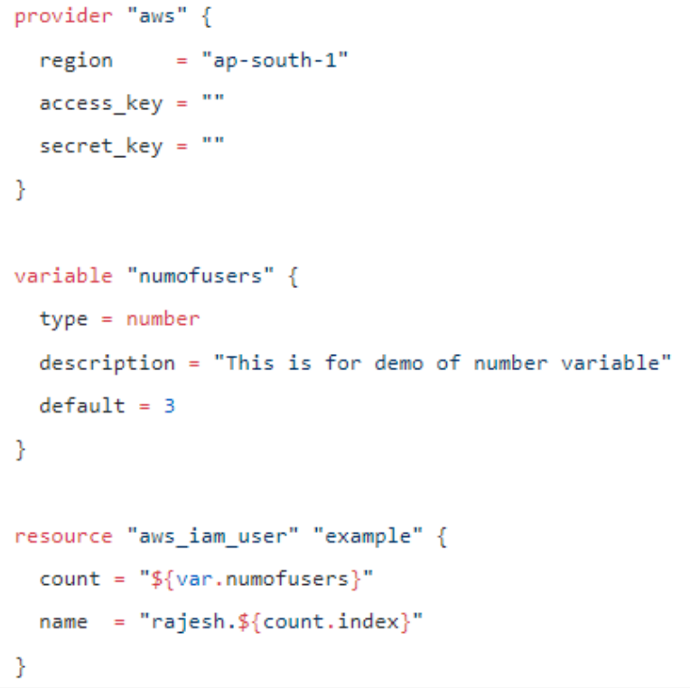
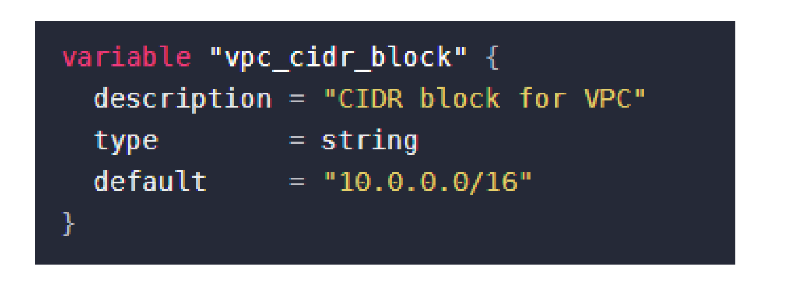
How to Declare

Slide 22
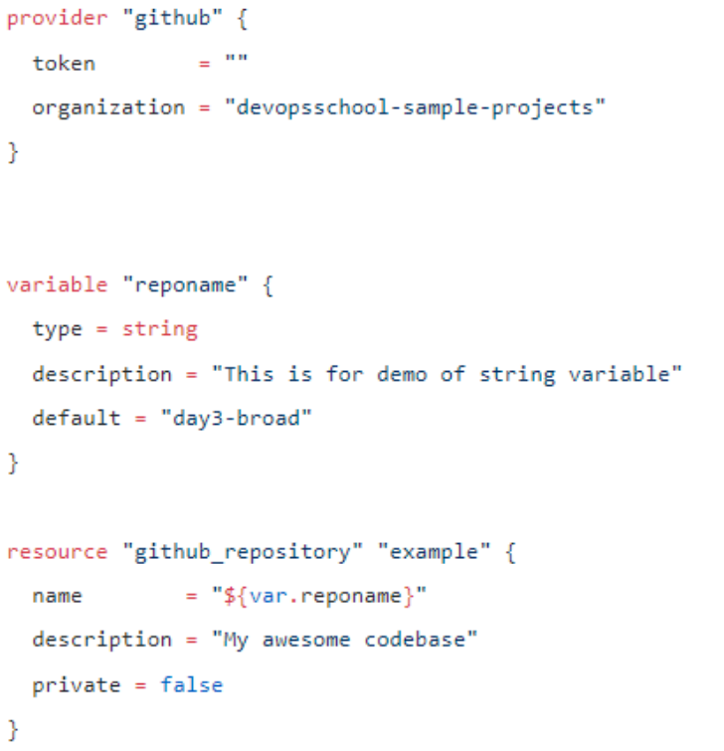
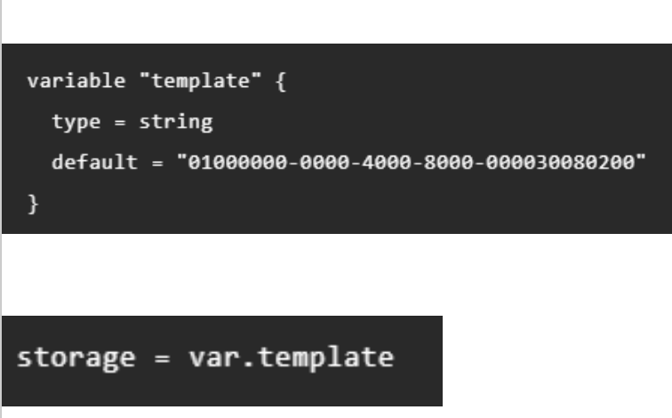
String

Slide 23
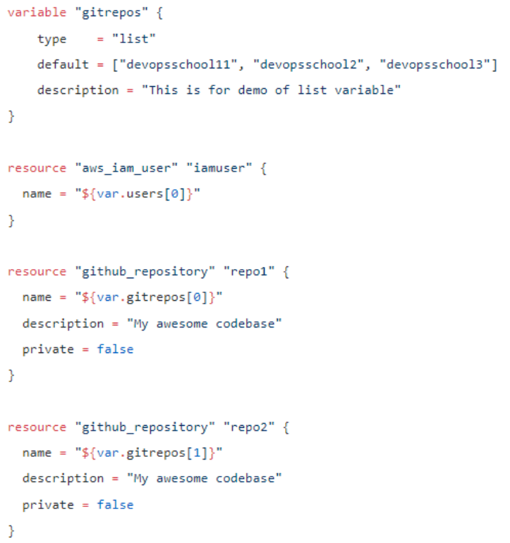
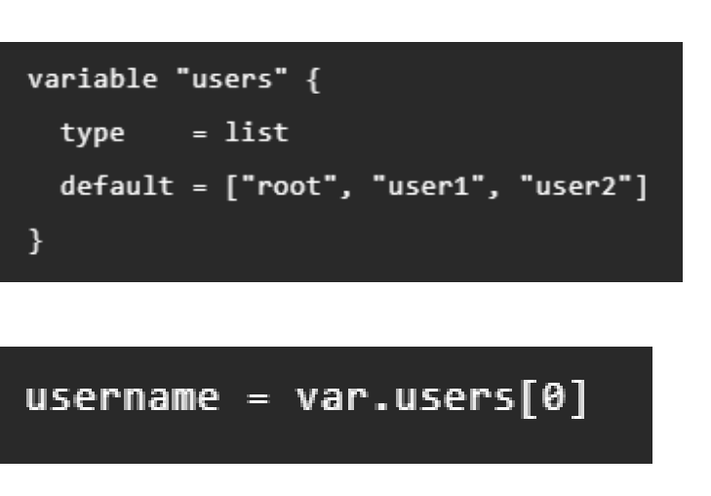
List

Slide 24
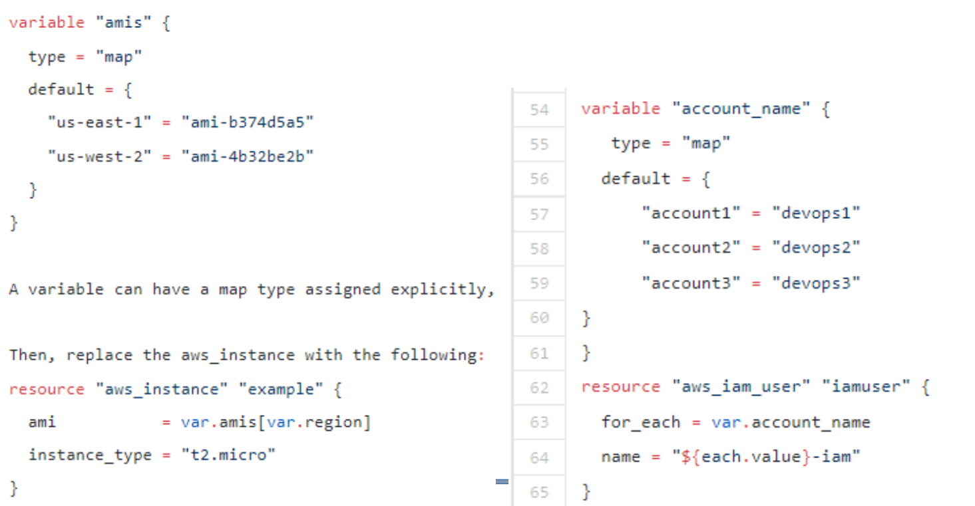
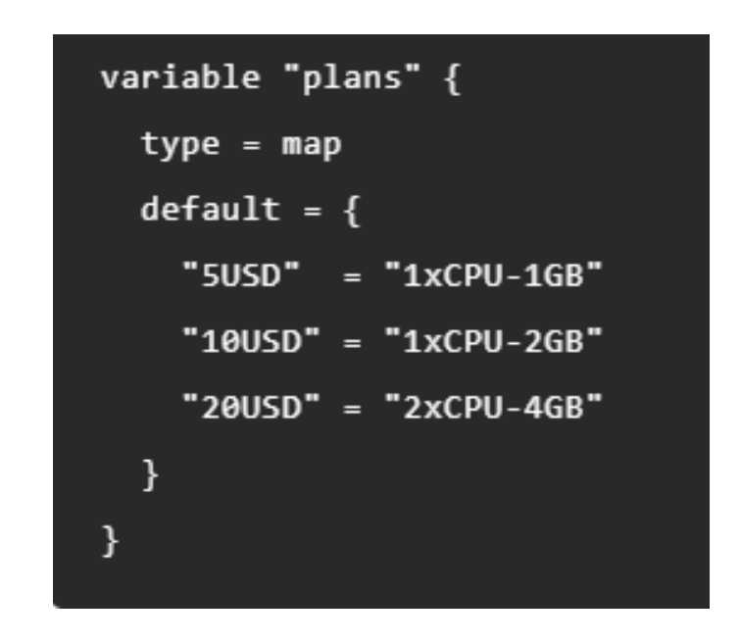
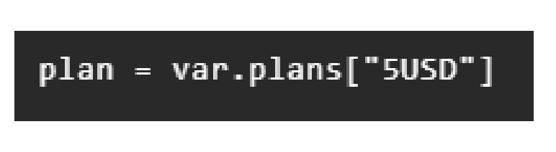
Map

Slide 25
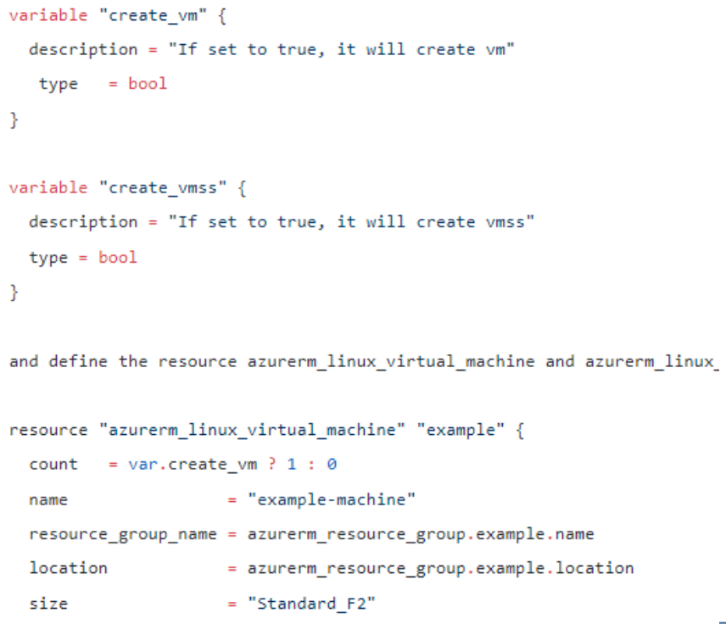
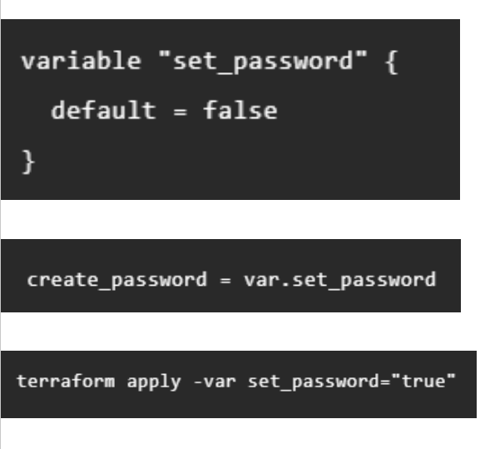
Bool

Slide 26
Terraform Variable: Output
Terraform will store hundreds or even thousands of attribute values for all the defined resources in our infrastructure in state file.
An outputted attributes can not only be used for the user reference but it can also act as an input to other resources being created via Terraform. We can use output variables to organize data to be easily queried and shown back to the Terraform user.
While Terraform stores hundreds or thousands of attribute values for all our resources, we are more likely to be interested in a few values of importance, such as a load balancer IP, VPN address, etc.
Output values are like the return values of a Terraform module, and have several uses: - A child module can use outputs to expose a subset of its resource attributes to a parent module. - A root module can use outputs to print certain values in the CLI output after running terraform apply. - When using remote state, root module outputs can be accessed by other configurations via a terraform_remote_state data source.

Slide 27
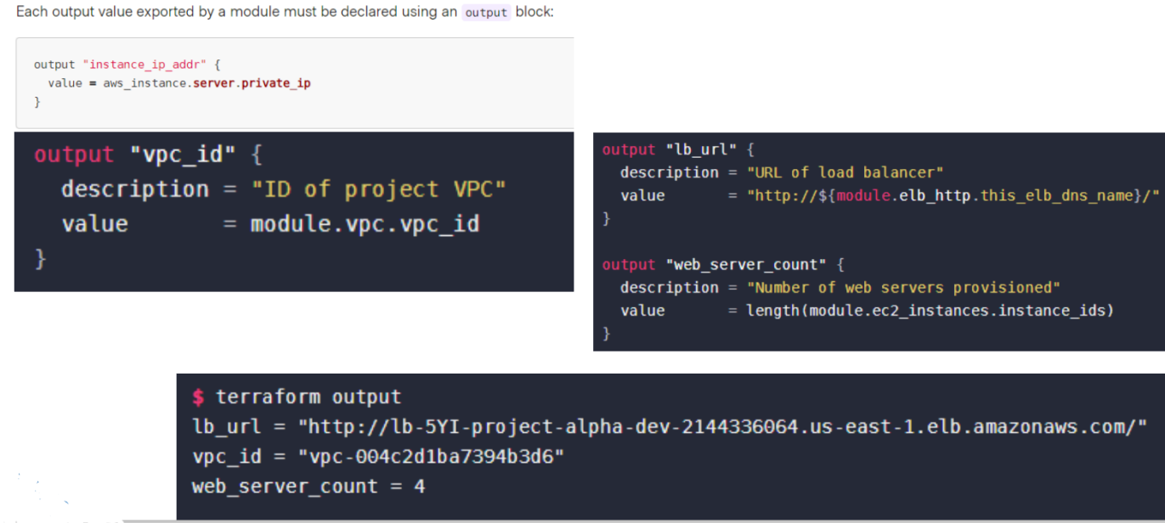
Terraform Variable: Output

Slide 28
Local Values
A local value assigns a name to an expression, so you can use the name multiple times within a module instead of repeating the expression.
If you're familiar with traditional programming languages, it can be useful to compare Terraform modules to function definitions:
Input variables are like function arguments.
Output values are like function return values.
Local values are like a function's temporary local variables.

Slide 29
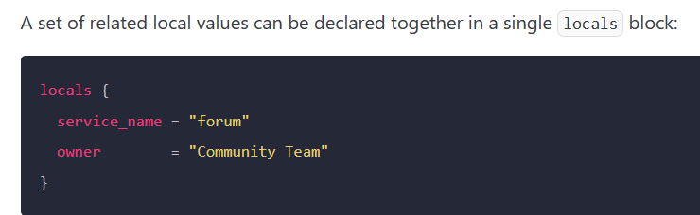
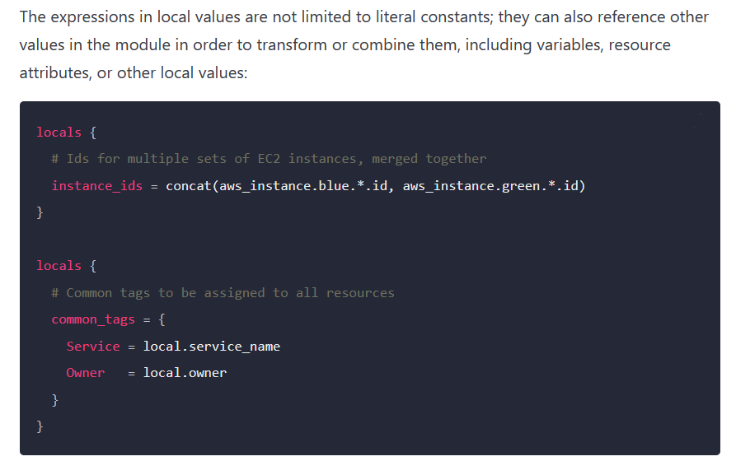
Local Values

Slide 30
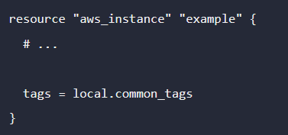
Using Local Values
Once a local value is declared, you can reference it in expressions as local.<NAME>.
Note: Local values are created by a locals block (plural), but you reference them as attributes on an object named local (singular). Make sure to leave off the "s" when referencing a local value!

Slide 31
When To Use Local Values
Local values can be helpful to avoid repeating the same values or expressions multiple times in a configuration, but if overused they can also make a configuration hard to read by future maintainers by hiding the actual values used.
Use local values only in moderation, in situations where a single value or result is used in many places and that value is likely to be changed in future. The ability to easily change the value in a central place is the key advantage of local values

Slide 32
Conditioning in Terraform
Conditional Expression
Depends_on

Slide 33
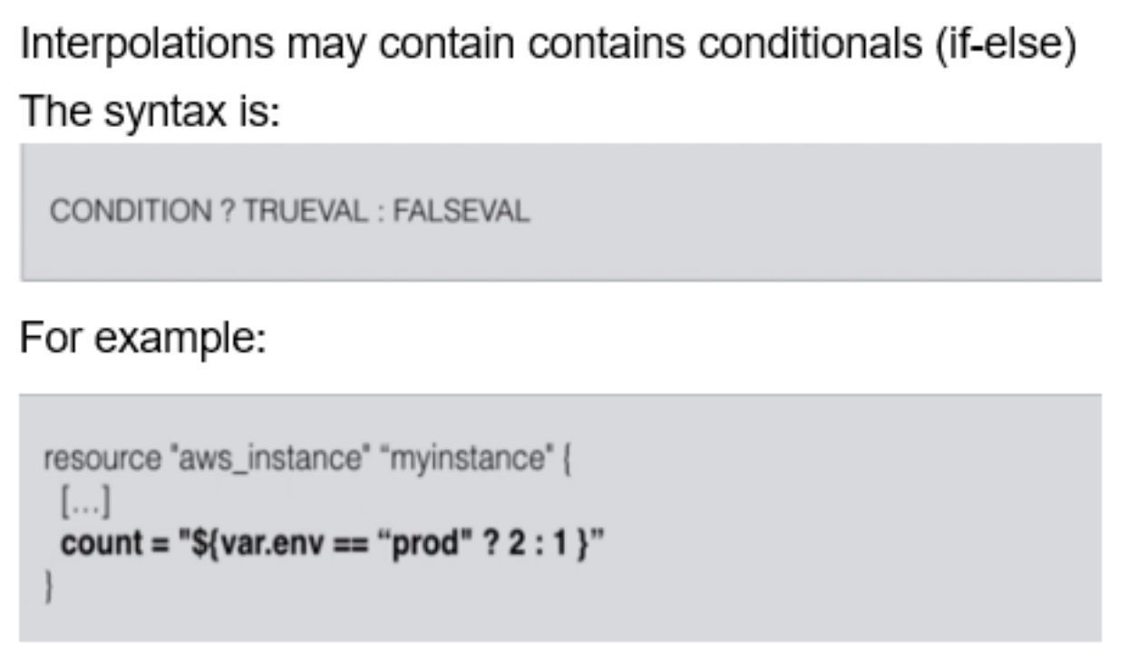
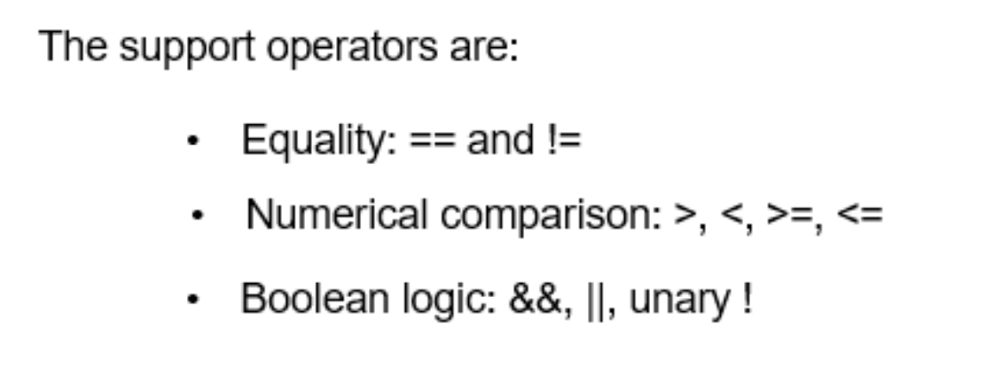
Conditional Expression

Slide 34
Interpolation
In Terraform, you can Interpolate other values, Using ${...}
You can use simple math functions, refer to other variables, or use conditionals (if-else)
I have been using them already throughout the course, without naming them
Variables: ${var.VARIABLE-NAME} refers to a variable
Resources: ${aws_instance.name.id} (type.resource-name.attr)
Data Source: ${data.template_file.name.rendered} (data.type.resourcename.attr)

Slide 35
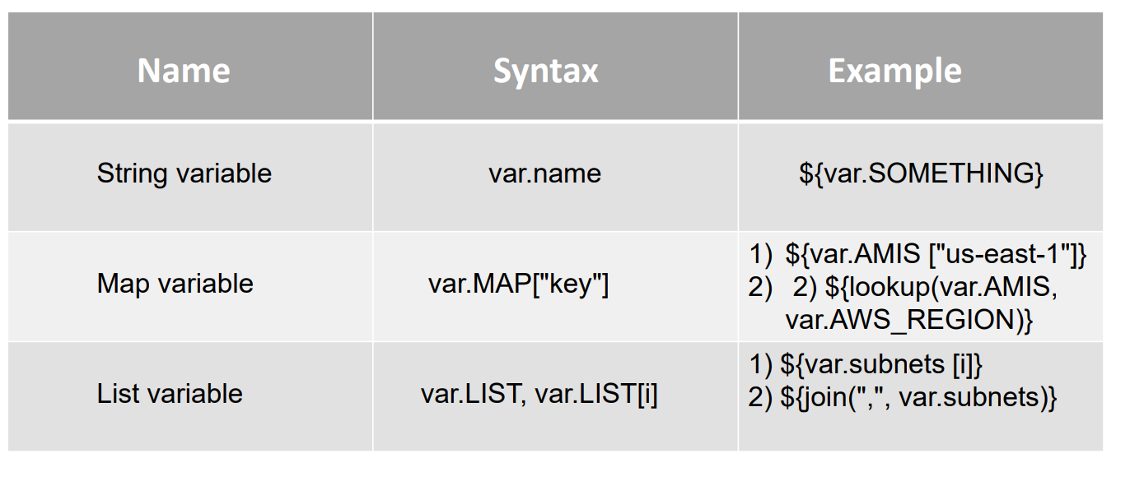
Interpolation: variables

Slide 36
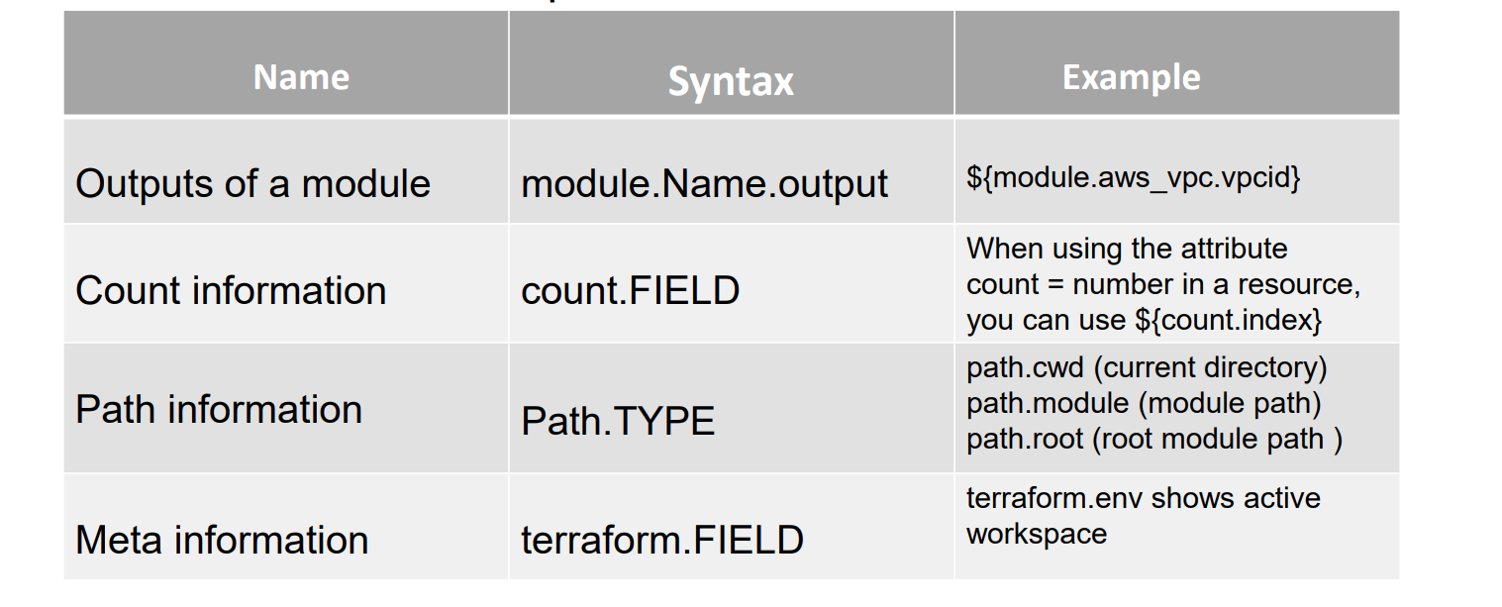
Interpolation: various

Slide 37
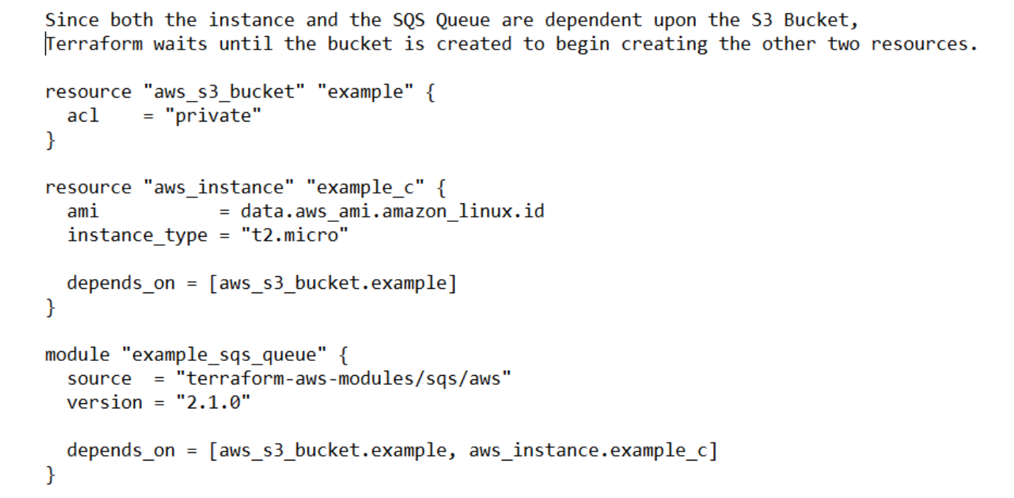
Depends On

Slide 38
Iterations in Terraform
For
For each

Slide 39
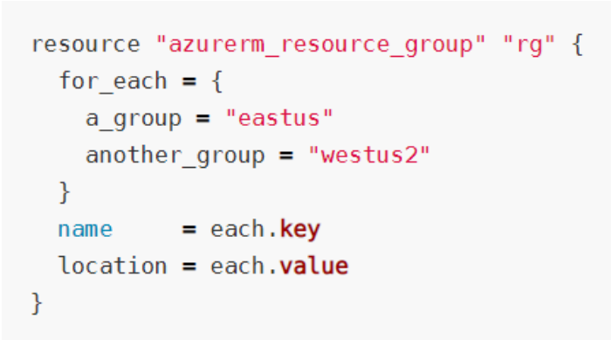
For Each
for_each is a meta-argument defined by the Terraform language. It can be used with modules and with every resource type.
The for_each meta-argument accepts a map or a set of strings, and creates an instance for each item in that map or set.
Each instance has a distinct infrastructure object associated with it, and each is separately created, updated, or destroyed when the configuration is applied.

Slide 40
Operators In Terraform
Arithmetic
Equality
Comparison
Logical

Slide 41
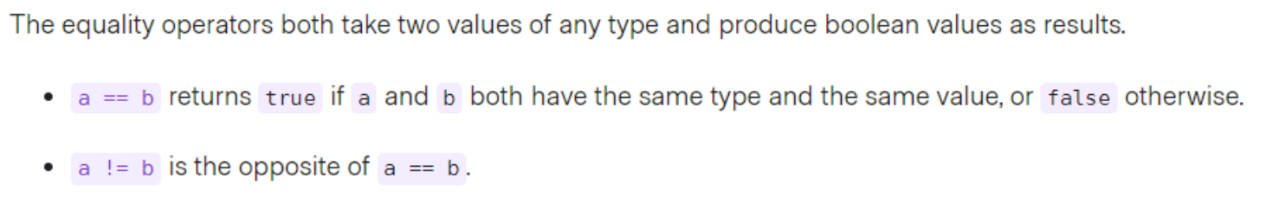
Equality Operators

Slide 42
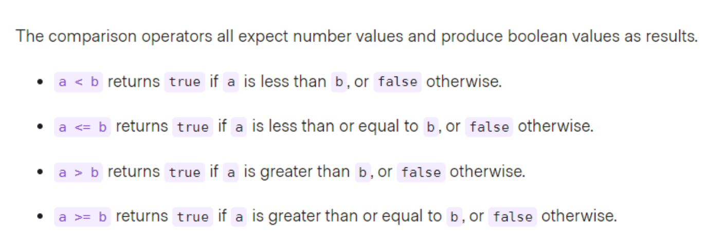
Comparison Operators

Slide 43
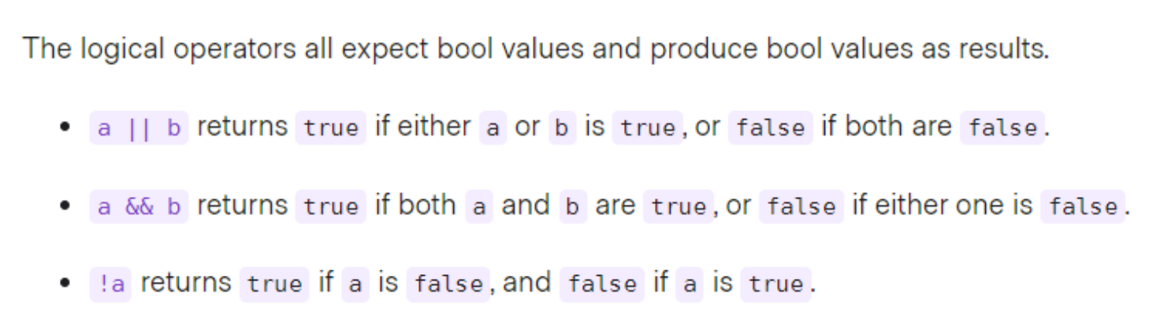
Logical Operators

Slide 44
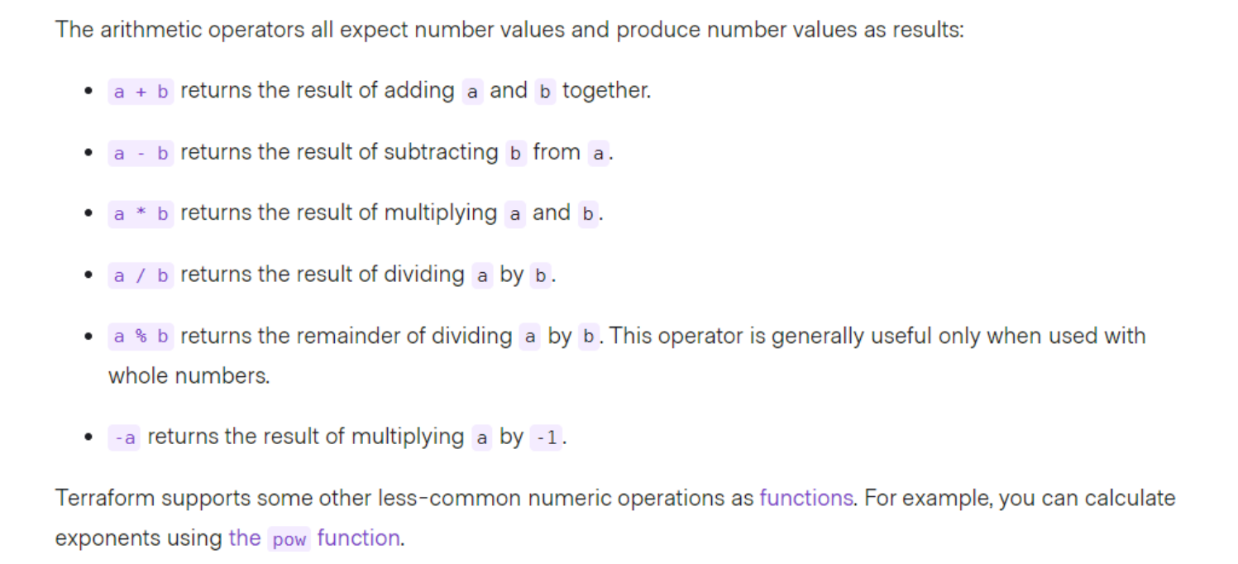
Arithmetic Operators

Slide 45
Data Source in Terraform
For certain providers (like AWS), terraform provides datasources
Datasources provide you with dynamic information A lot of data is available by AWS in a structured format using their API Terraform also exposes this information using data sources
Examples: list of AMIs List of availability Zones
Another great example is the datasource that gives you all IP addresses in use by AWS
This is great if you want to filter traffic based on an AWS region e.g. allow all traffic from amazon instances in Europe
Filtering traffic in AWS can be done using security groups Incoming and outgoing traffic can be filtered by protocol, IP range, and port Similar to iptables (Linux) or a firewall appliance

Slide 46
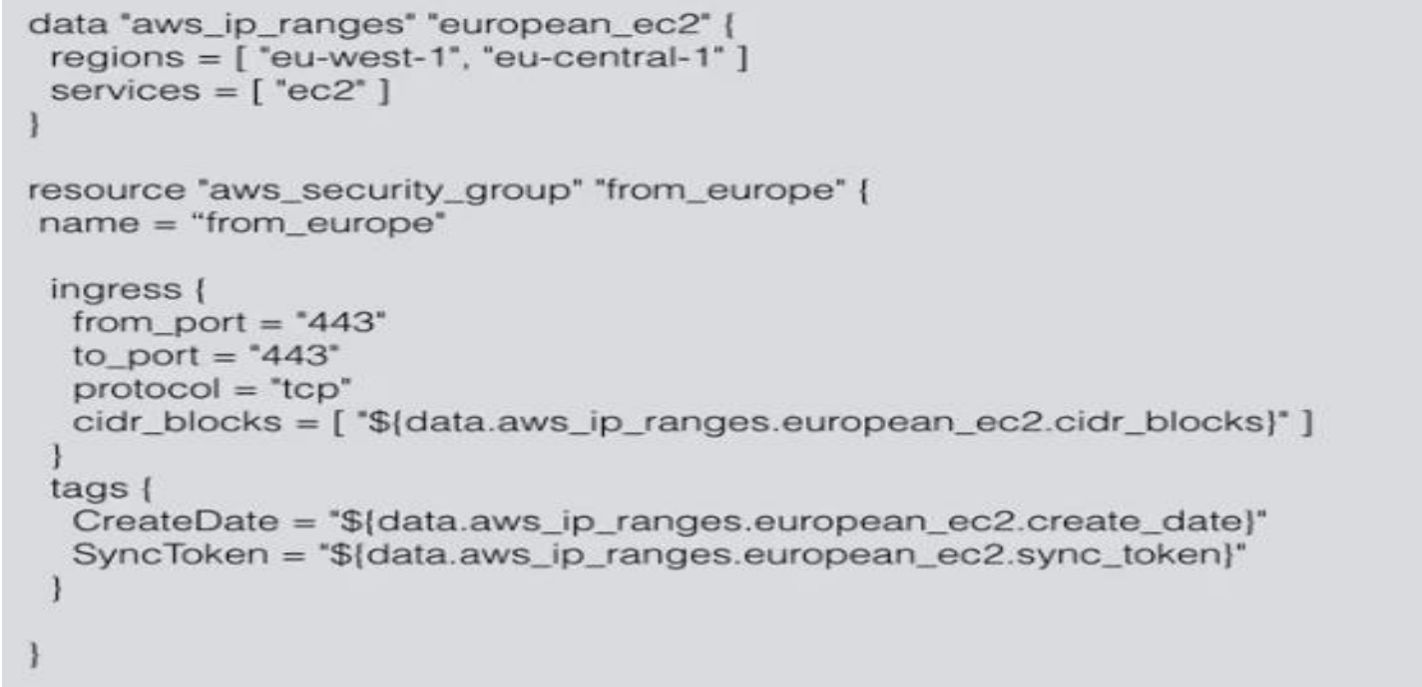
Data Source in Terraform

Slide 47
Terraform Functions
The Terraform language includes a number of built-in functions that you can call from within expressions to transform and combine values. The general syntax for function calls is a function name followed by comma separated arguments in parentheses:
max(5,12,9)

Slide 48
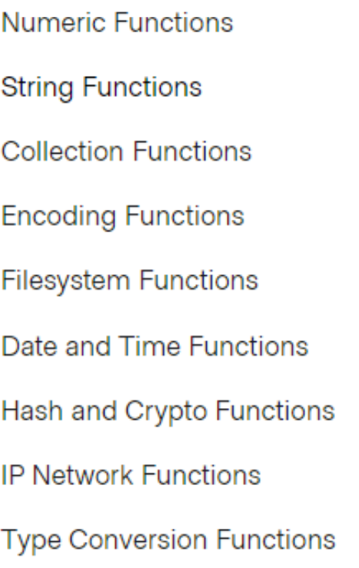
Function Types

Slide 49
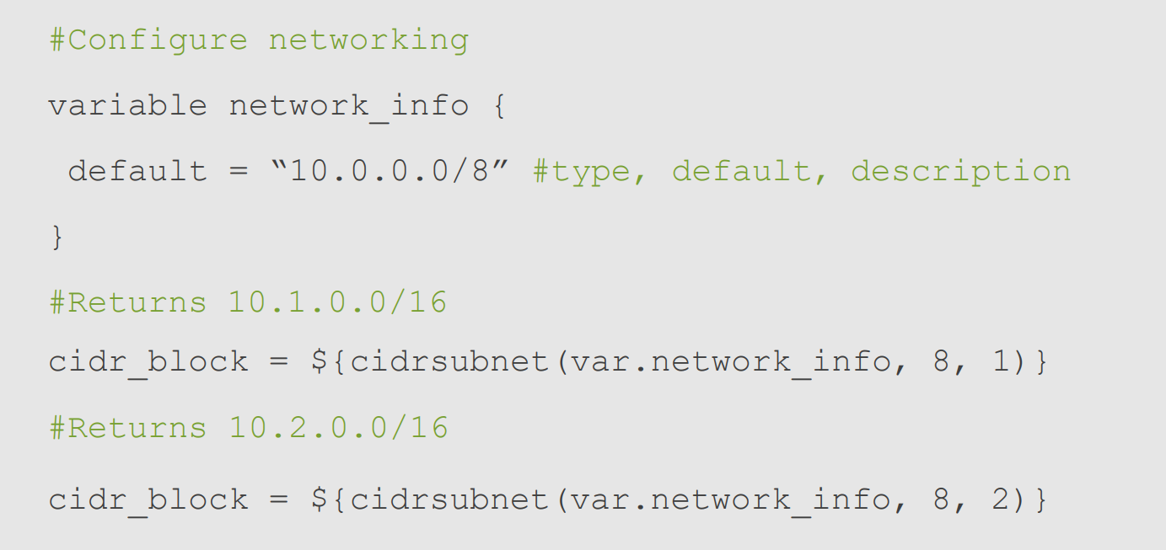
Function Example

Slide 50
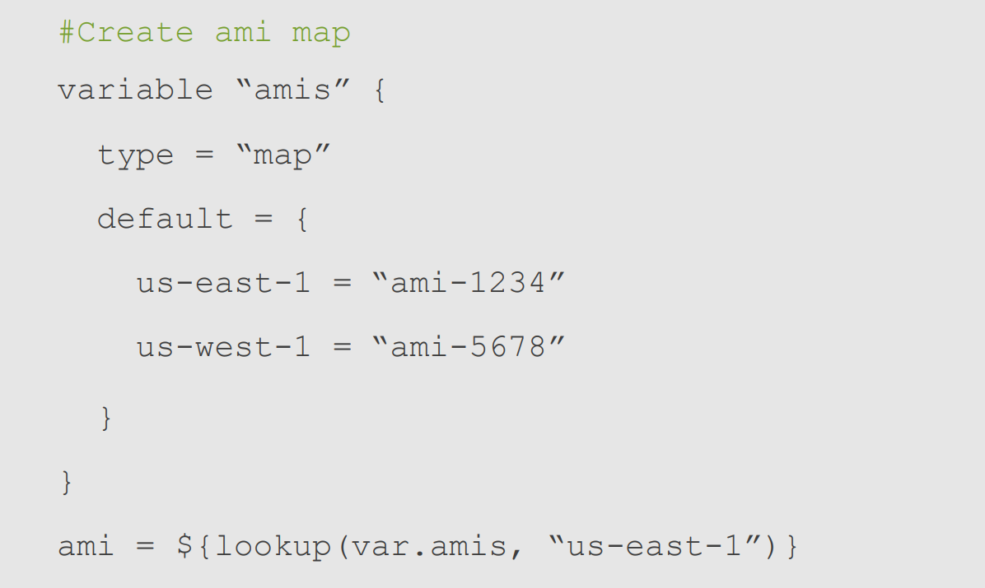
Function Example

Slide 51
Module
A module is a container for multiple resources that are used together.
Every Terraform configuration has at least one module, known as its root module, which consists of the resources defined in the .tf files in the main working directory.
A module can call other modules, which lets you include the child module's resources into the configuration in a concise way. Modules can also be called multiple times, either within the same configuration or in separate configurations, allowing resource configurations to be packaged and re-used.

Slide 52
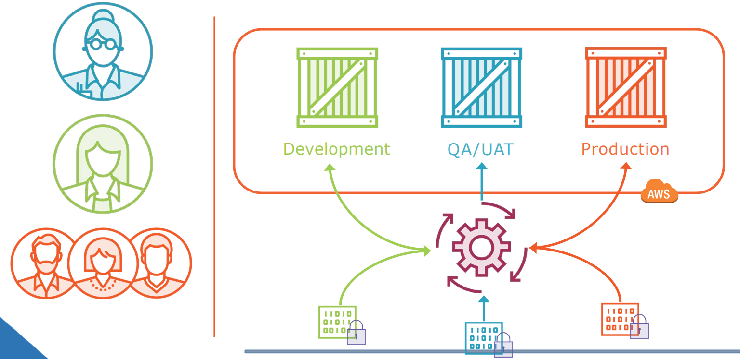
Multi ENV Scenario

Slide 53
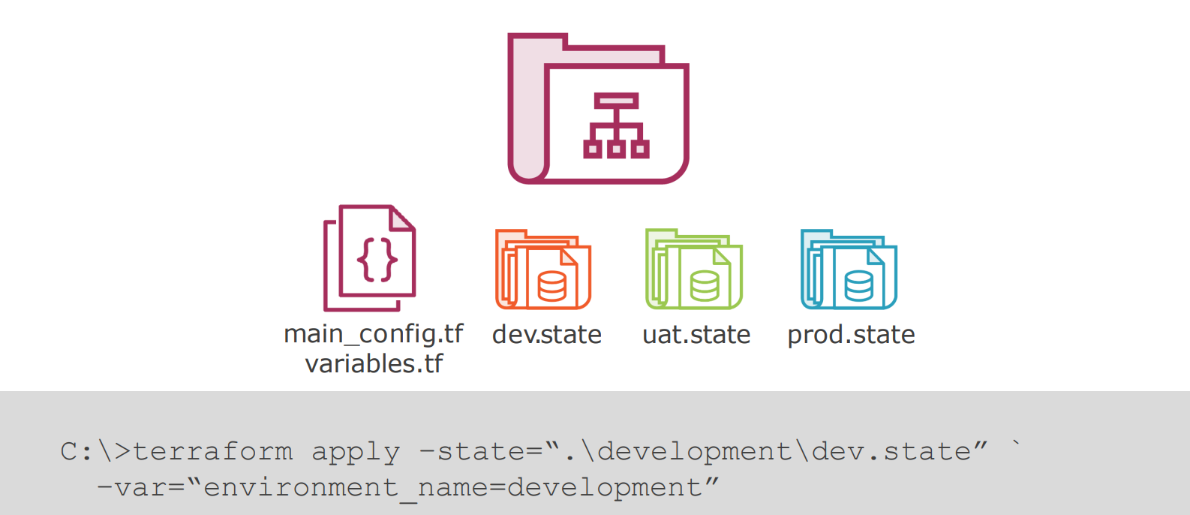
State File Solution

Slide 54
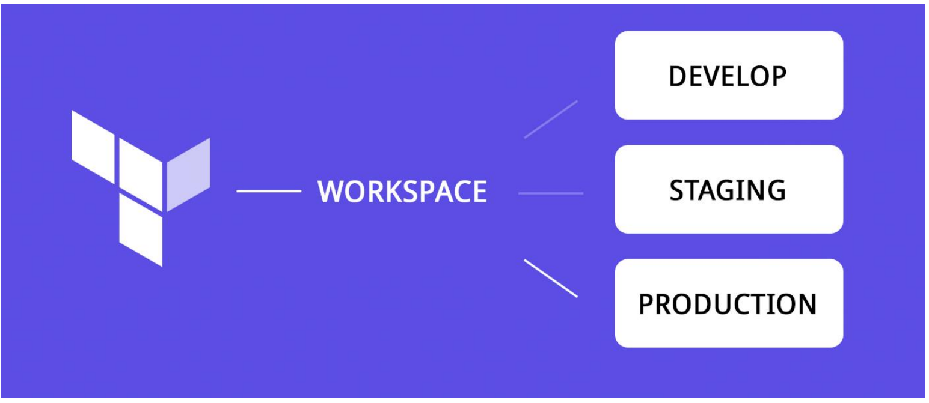
Terraform Workspace: Solution

Slide 55
Terraform Workspace
Terraform starts with a single, default workspace named default that you cannot delete. If you have not created a new workspace, you are using the default workspace in your Terraform working directory.
When you run terraform plan in a new workspace, Terraform does not access existing resources in other workspaces. These resources still physically exist, but you must switch workspaces to manage them.
Refer to the Terraform CLI workspaces documentation for full details about how to create and use workspaces. (https://developer.hashicorp.com/terraform/cli/workspaces)

